Slide 1


Course Title: Artificial Intelligence (Machine Learning & Deep Learning) MATPLOTLIB LIBRARY
Prepared by: Dr. Zafi Sherhan Shah & Engr. Ahrar Bin Aslam
ahrar.aslam@admin.muet.edu.pk
Department of Telecommunication Engineering
Mehran University of Engineering and Technology

Slide 2
Introduction
In this lab, you’ll learn how to use the Matplotlib package to generate graphs for your data using python
If you haven’t already installed matplotlib, type pip install matplotlib in Conda prompt
(you can type !pip install matplotlib from within spyder too)

Slide 3
Basics
Plotting a 2D graph, with x and y axes, is straight forward.
Example
import matplotlib.pyplot as plt
import numpy as np
x_data = np.array([1, 2, 3, 4, 5])
y_data = np.array([2500, 3500, 2750, 2200, 2600])
plt.plot(x_data, y_data)
plt.show()
Example: calories intake for 5 consecutive days

Slide 4
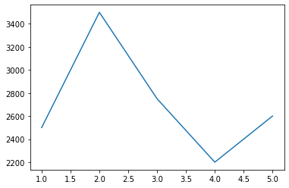

Slide 5
This graph has several flaws, including:
There is no indication of the variable on x-axis
There is no indication of the variable on y-axis
There is no indication about what this data is about
We need to address it

Slide 6
Adding a title, x- and y- labels
We can add a title, as well as x- and y- labels to our graph in order to make it easier to interpret and understand
x_data = np.array([1, 2, 3, 4, 5])
y_data = np.array([2500, 3500, 2750, 2200, 2600])
plt.plot(x_data, y_data)
plt.xlabel("day #")
plt.ylabel("calories intake")
plt.title("Daily intake of calories")
plt.show()

Slide 7
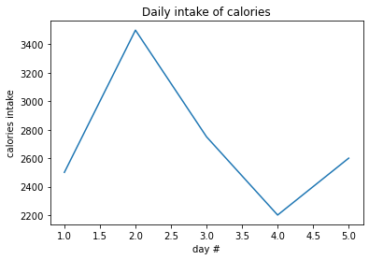
Better?

Slide 8
Adding a grid
Although the graph was easier to understand after the addition of title and x/y labels, it is difficult to get precise values for x- and y-axes
We can improve this by adding a grid

Slide 9

plt.plot(x_data, y_data)
plt.xlabel("day #")
plt.ylabel("calories intake")
plt.title("Daily intake of calories")
plt.grid()
plt.show()

Slide 10
Creating aesthetically better graphs
We improve the aesthetic quality of the graph by
Changing line colour, style
plt.plot(x_data,y_data, color=‘red’)
You can also use different color codes, e.g= #7e94bb
Add markers
And changing marker size, colour, and type

Slide 11
plt.plot(x_data, y_data,
linestyle="-.", color="k", linewidth="4",
marker="o", markersize=10, markeredgecolor="r", markerfacecolor="r")
plt.xlabel("day #")
plt.ylabel("calories intake")
plt.title("Daily intake of calories")
plt.grid()
plt.show()

Slide 12
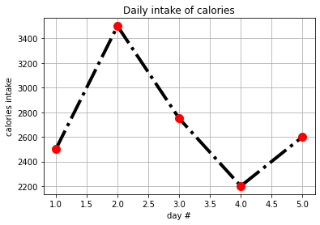
Old graph
New graph

Slide 13
Commonly used marker options include:
'o', '*', '.', 'x'
Commonly used colours include
'r', 'g', 'b', 'c', 'm', 'y' and 'k'

Slide 14
Commonly used line styles include
'-' = solid line
':' = dotted line
'--' = dashed line
'-.' = dash-dot line
'' = no line
Try this out:
plt.plot(x_data,y_data,'g+', markersize=15)

Slide 15
Alpha parameter:
plt.plot(x_data,y_data,alpha=0.5)
The values of alpha ranges from 0 to 1, where 0 means opaque and 1 means transparent. You can specify any value in between.
Try it out yourself.

Slide 16
Plot with multiple data:
days=[1,2,3,4,5,6,7]
max_t=[44,54,42,47,51,45,48]
min_t=[33,36,38,41,42,38,43]
avg_t=[42,43,39,40,45,44,40]
plt.title("Weather")
plt.xlabel("Days")
plt.ylabel("Temperature")
plt.plot(days,max_t, label="Max", color="Blue", linestyle="--")
plt.plot(days,min_t, label="Min", color="Red", linestyle="--")
plt.plot(days,avg_t, label="Avg", color="Green", linestyle="--")
plt.legend(loc="best", shadow=True, fontsize="large") #loc= The location of the legend
plt.grid()

Slide 17
Subplots
We like to use subplots (multiple graphs in the same figure) when we want to view two sets of data simultaneously
Typically, for the sake of comparison
The subplot() function takes three arguments that describes the layout of the figure.
The layout is organized in rows and columns, which are represented by the first and second argument.
The third argument represents the index of the current plot.

Slide 18
# data of user 1
x_data_1 = np.array([1, 2, 3, 4, 5])
y_data_1 = np.array([2500, 3500, 2750, 2200, 2600])
# data of user 2
x_data_2 = np.array([1, 2, 3, 4, 5])
y_data_2 = np.array([2300, 3000, 2450, 2900, 2100])
plt.subplot(2, 1, 1)
plt.plot(x_data_1,y_data_1)
plt.xlabel("day #")
plt.ylabel("calories intake")
plt.title("Daily intake of calories")
plt.grid()

Slide 19
plt.subplot(2, 1, 2)
plt.plot(x_data_2,y_data_2)
plt.xlabel("day #")
plt.ylabel("calories intake")
plt.title("Daily intake of calories")
plt.xlabel("day #")
plt.ylabel("calories intake")
plt.title("Daily intake of calories")
plt.grid()
plt.tight_layout()
plt.show()

Slide 20
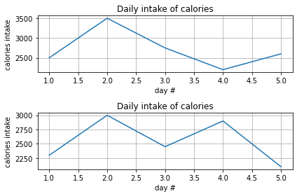

Slide 21
Saving figures onto your drive
import matplotlib.pyplot as plt
import numpy as np
x_data = np.array([1, 2, 3, 4, 5])
y_data = np.array([2500, 3500, 2750, 2200, 2600])
plt.plot(x_data, y_data,
linestyle="-.", color="k", linewidth="4",
marker="o", markersize=10, markeredgecolor="r", markerfacecolor="r")
plt.xlabel("day #")
plt.ylabel("calories intake")
plt.title("Daily intake of calories")
plt.grid()
plt.savefig("D:/delete_image.png", dpi=300)
plt.show()

Slide 22
Bar charts using Matplotlib
x=np.array([1,2,3,4,5])
y=np.array([500,600,1000,400,200])
plt.barh(x,y)
plt.show()
The following code displays horizontal bar chart.
By using plt.bar(x,y) you can visualize the data in conventional bar chart format.
Search about the width and height parameter.

Slide 23
Scatter Plots using Matplotlib
With Pyplot, you can use the scatter() function to draw a scatter plot.
The scatter() function plots one dot for each observation. It needs two arrays of the same length, one for the values of the x-axis, and one for values on the y-axis:
plt.scatter()
plt.show()

Slide 24
Comparing two datapoints using scatterplot
x=np.array([1,2,3,4,5])
y=np.array([33,74,105,44,66])
plt.scatter(x,y)
x=np.array([1,2,3,4,5])
y=np.array([98,45,66,72,104])
plt.scatter(x,y)
plt.title('Comparing two datapoints')
plt.show()

Slide 25



Activities
Generate a graph for the following equations.
1
2
3
$$y\left(x\right)=x^{2}+2x−10$$
$$h\left(t\right)=11t −10$$
$$p\left(q\right)={0.5q}^{3}+{3q}^{2}−5q+5$$

